Slide 1
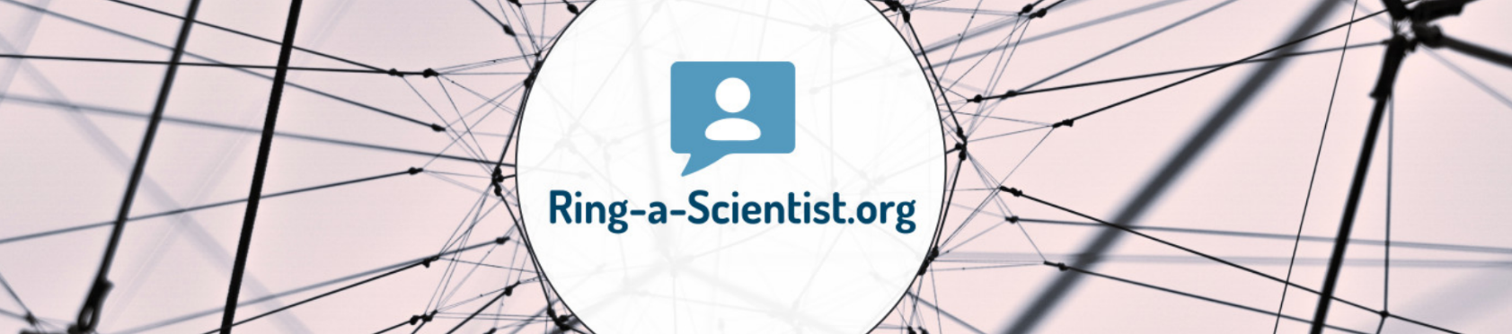
Live:
From the lab into the classroom

Slide 2
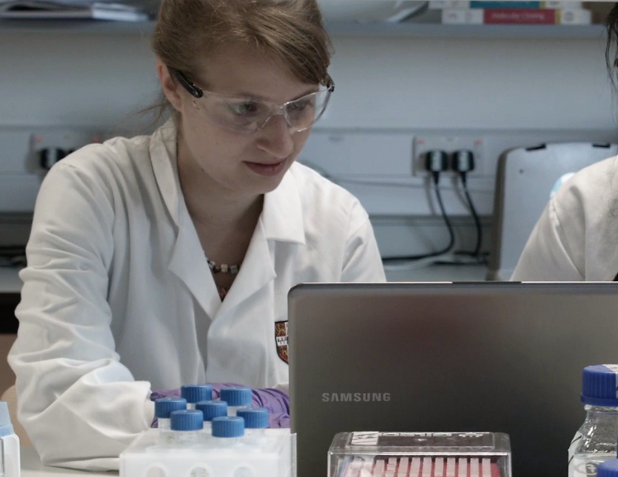
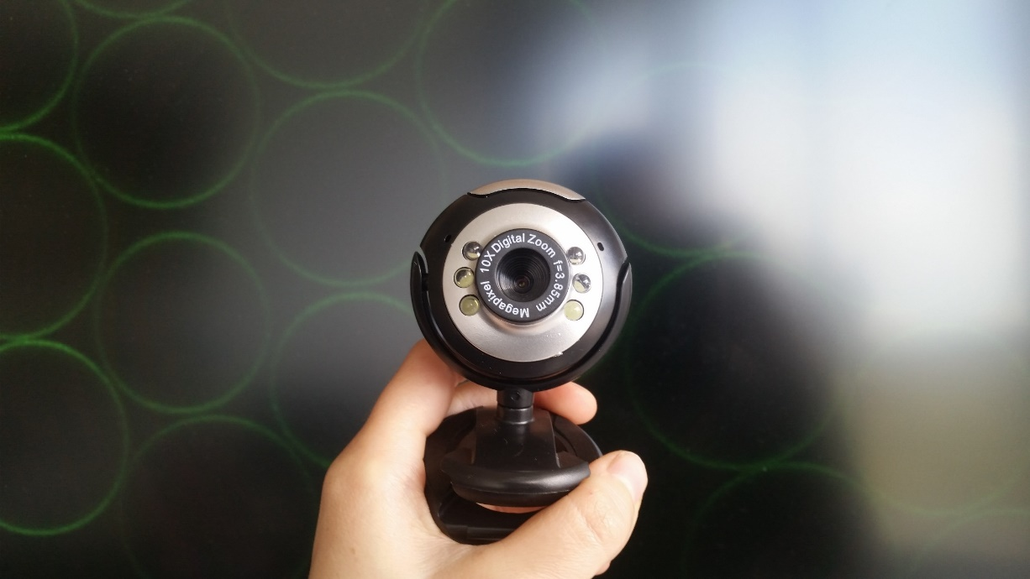

Pictures
P. Rothemund, Nature, 2006

Slide 3
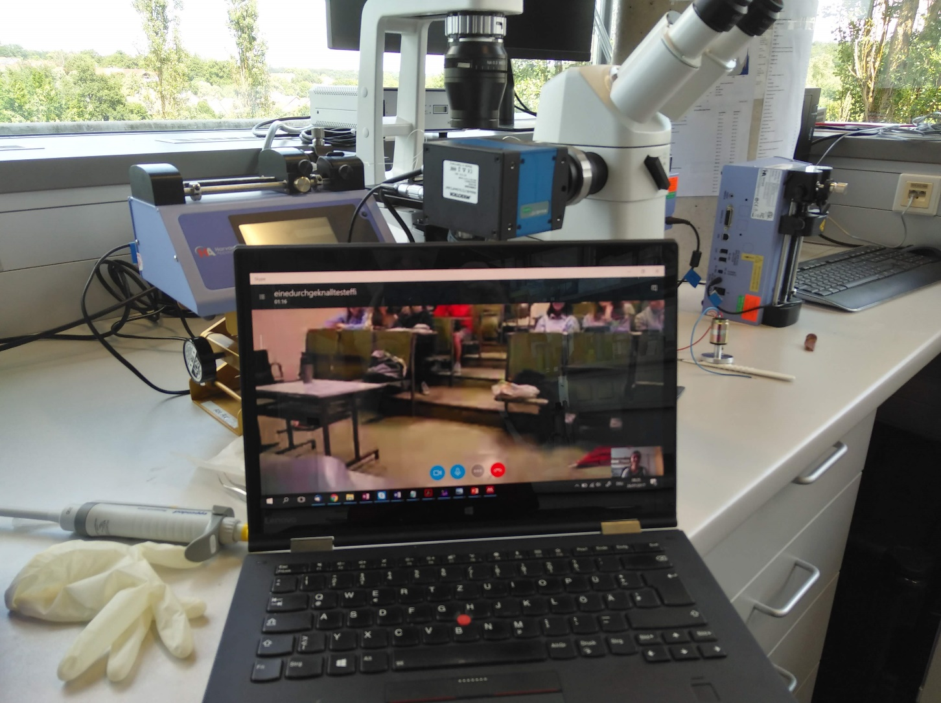
Pictures
P. Rothemund, Nature, 2006

Slide 4
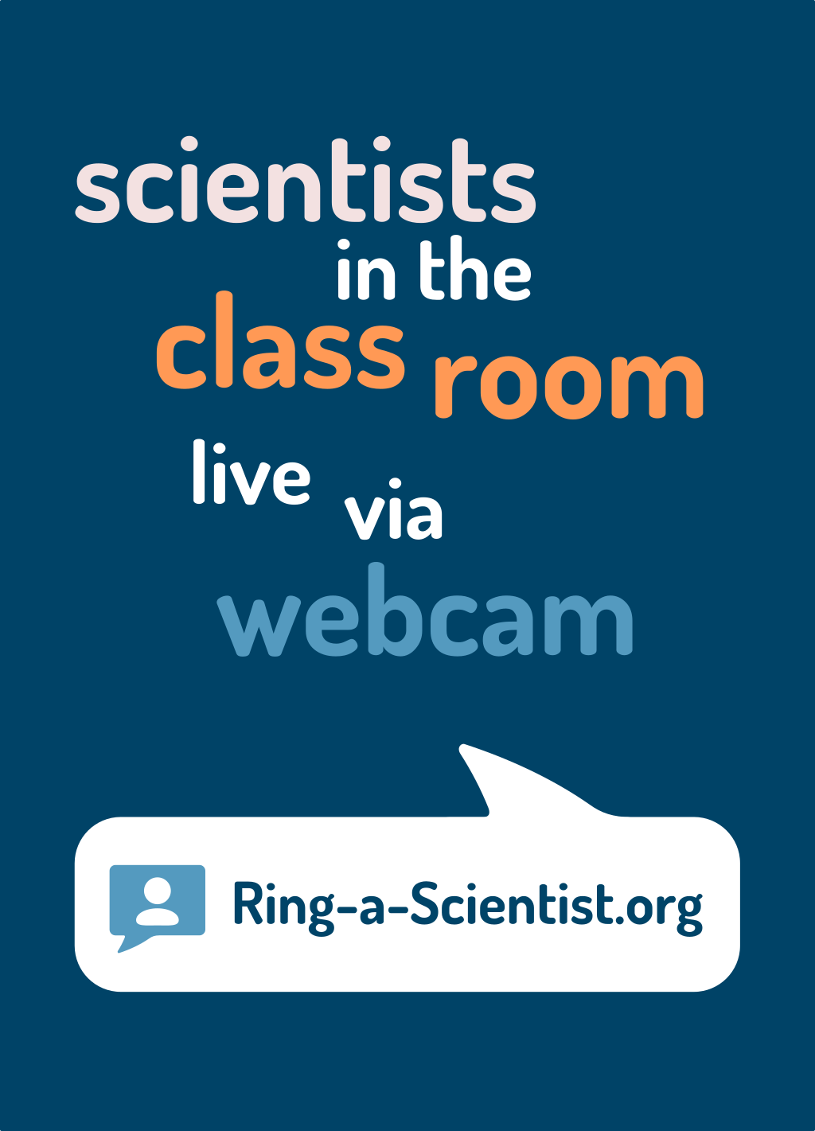
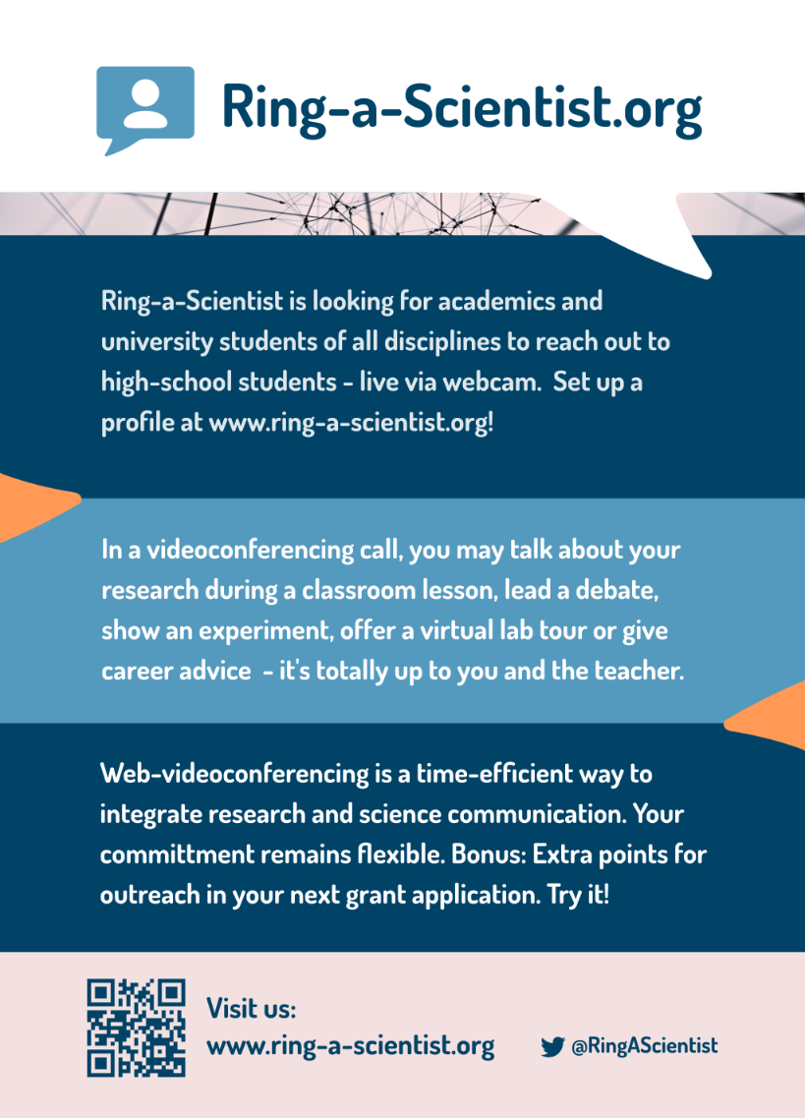
Flyer

Slide 5
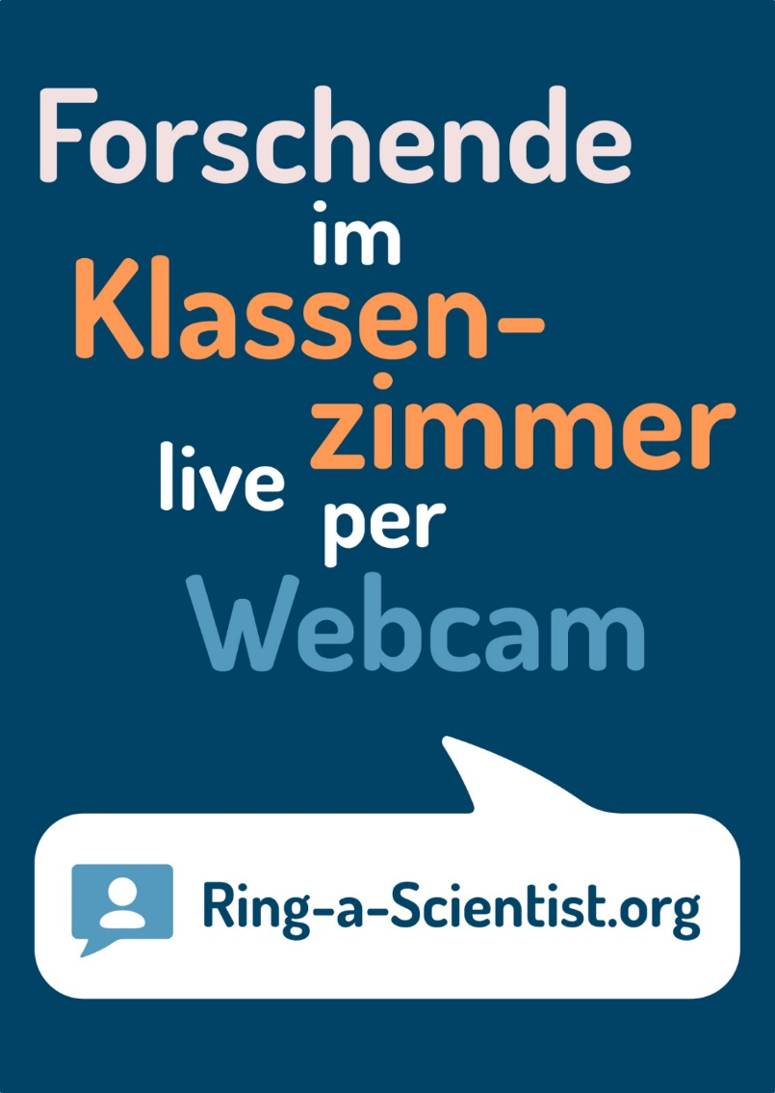
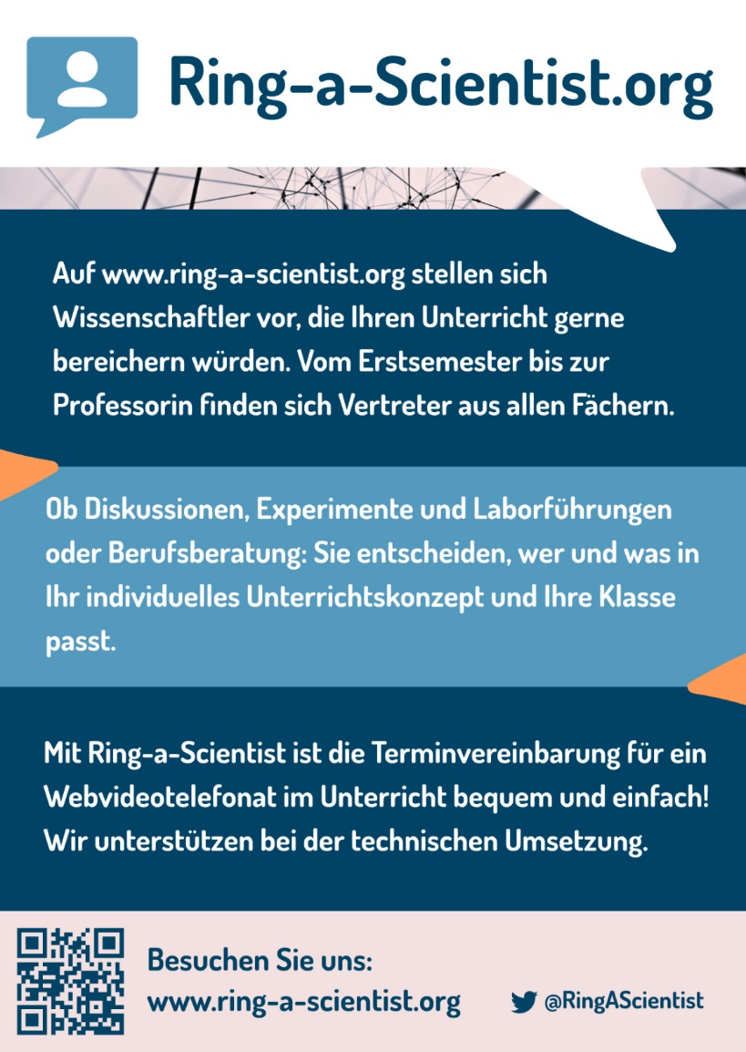
Flyer

Slide 6
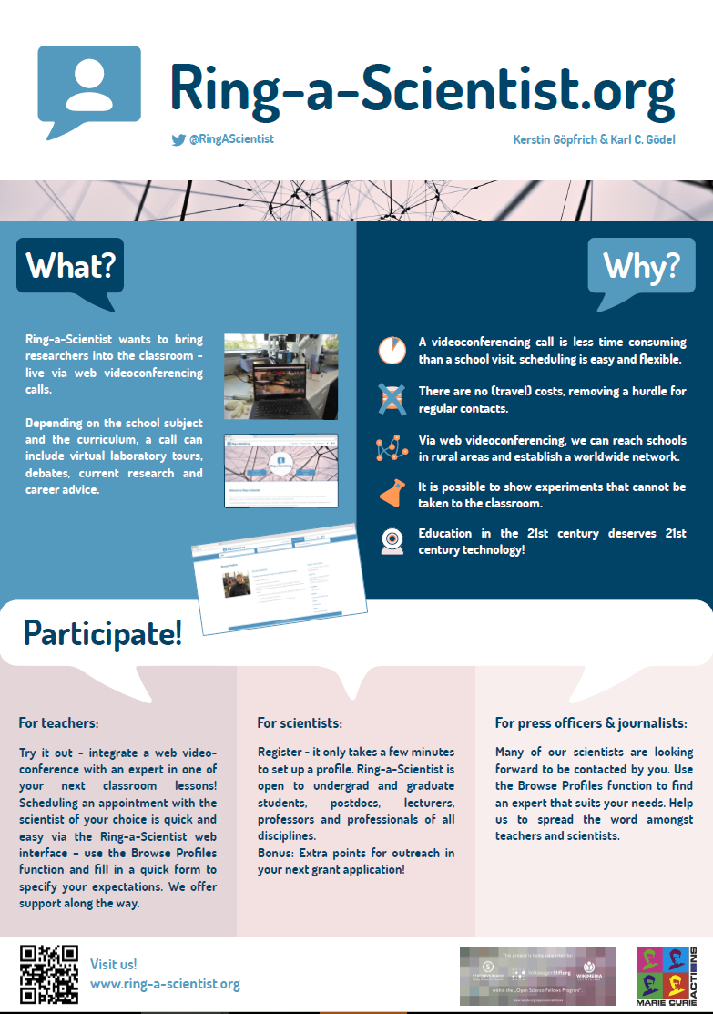
Poster

Slide 7
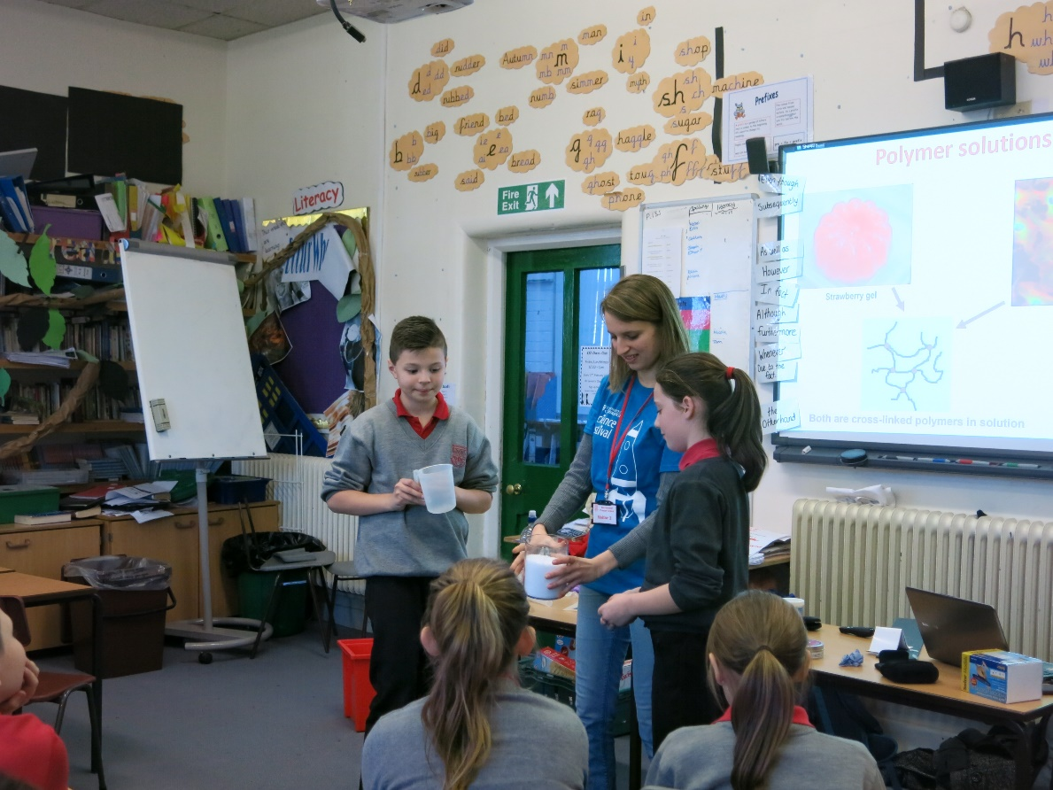
From the lab into the classroom
Class visits are great – but time consuming!

Slide 8
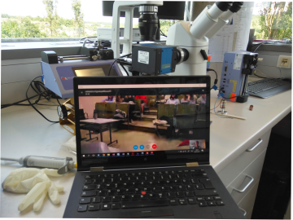
From the lab into the classroom
Notes:
.

Slide 9




Why videoconferences?
A videoconference…
… saves money.
… saves time.
… reaches school in rural areas and around the world.
… makes it possible to show experiments.
Teaching in the 21st century deserves 21st century technology!

Slide 10
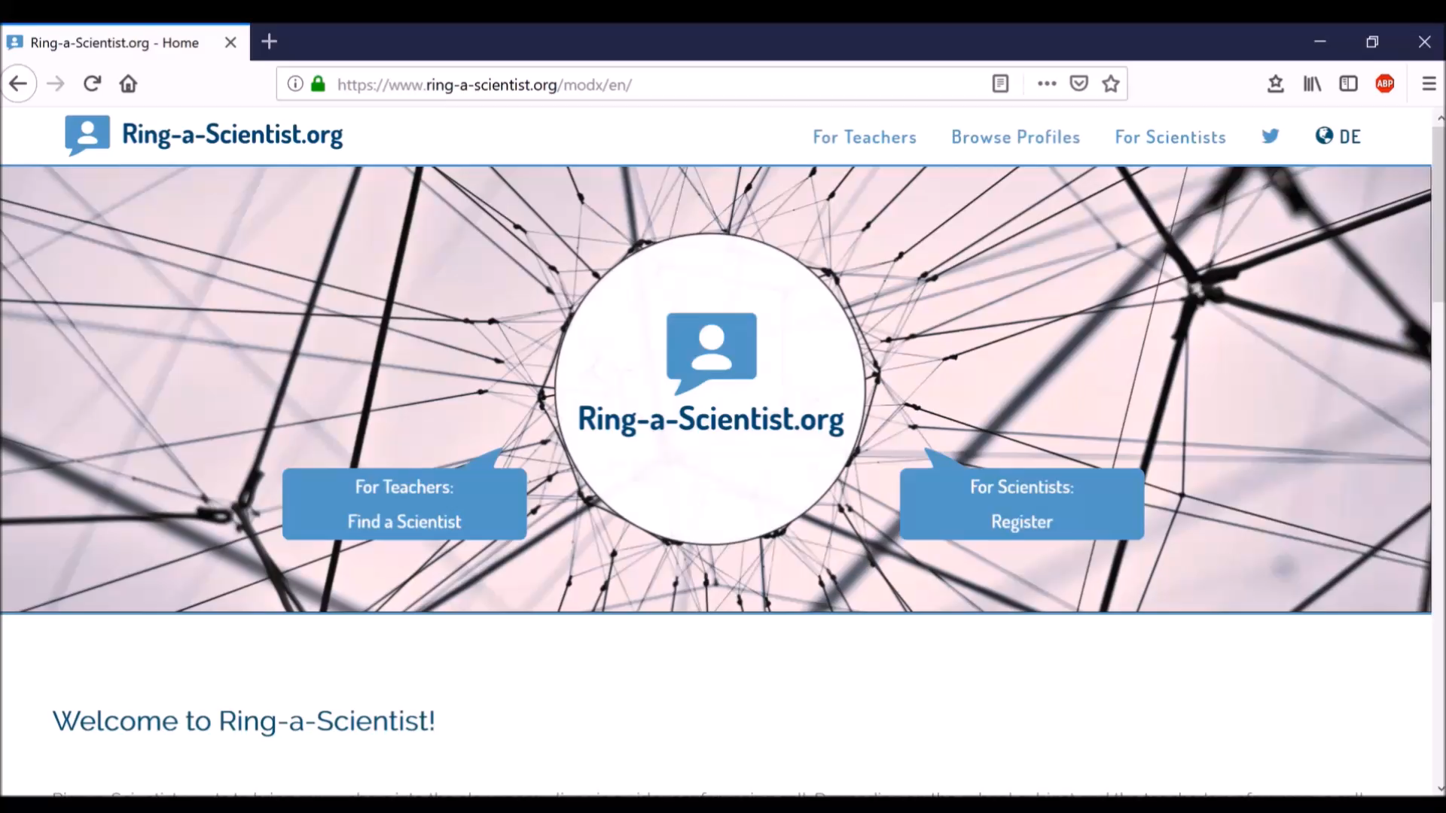
Participate – for scientists

Slide 11
Participate – for teachers

Slide 12
Ring-a-Scientist today
Since June 2018:
~150 registered scientists
From professors to bachelor students, industry experts
About half are female, half are male
Video conferences in ~10 languages (i.e. German, English, Spanish, French, Mandarin, Swedish, Hebrew, Czech, Russian)
About 2 video conferences per months (Please tell your teacher friends!)
Several calls during homeschooling period due to COVID-19
1x scientist as a museum exhibit
Highlights in several media outlets (BIOspektrum, SWR2, Deutsche Universitätszeitung, Biologie in unserer Zeit)
Active collaboration with Scientists for Future

